Slide 1
DMIT 1530
Week 2
Optimising Images for the Web

Slide 2
Performance matters.

Slide 3
A website needs to load quickly, load lightly, and behave in a way that users expect it to.

Slide 4
Performance is about retaining users.
If your page doesn’t load quickly, users will bounce.

Slide 5
It’s also about improving conversions.

Slide 6
A conversion is an action we want our users to take (i.e. we’re converting them from passive viewers to active participants).
It could be making a donation, buying something, or signing up for an account.

Slide 7
And it’s about user experience (UX).

Slide 8
In a 2016 study, lag and slower load times caused a stress response similar to watching a horror film or solving a mathematical problem.

Slide 9
Alright, so performance is important —
and images are a big part of performance.

Slide 10
Common File Types
More acronyms than you
can shake a stick at.

Slide 11
You’re probably already comfortable with the big three image formats:
GIFs
JPEGs
PNGs

Slide 12
GIFs can have multiple frames (i.e. animations) and are good for icons.
However, they have a limited colour palette and animated GIFs can have massive file sizes.

Slide 13
JPEGs are great for photos. Because they are compressed, they can have smaller file sizes.
However, they do not support CMYK and their compression algorithm makes them terrible for text.

Slide 14
PNGs are lossless and support transparency. However, the file sizes can be massive, especially if there are a wide range of colours in the image.

Slide 15
These file types are universally supported.
However, there are newer file types with even more features and smaller file sizes.

Slide 16
Let’s talk about JPEG XR, WebP, and SVG
file formats.

Slide 17
JPEG XR
JPEG, but with more … XR.

Slide 18
JPEG XR is Microsoft’s solution to modern, lightweight images for the web.
They rewrote the compression algorithm, giving these filetypes greater clarity.

Slide 19
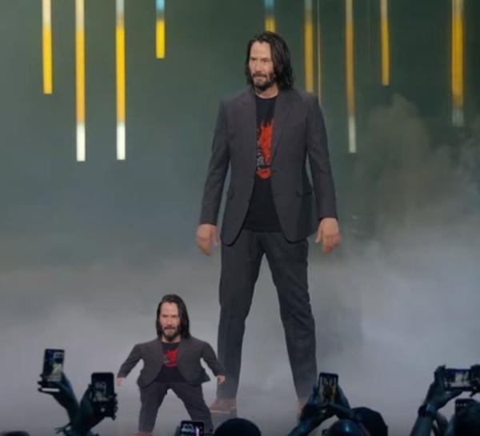
JPEG XR
JPEG

Slide 20
However, in order to create a JPEG XR, you will need a special third-party plugin for Photoshop.
For our purposes, it’ll be easier to use WebP and SVG files.

Slide 21
WebP
Don’t talk to me or my JPEG XR ever again.

Slide 22
WebP is Google’s answer to the same problem.
WebP images are 25-35% smaller than JPEGs
and 80% smaller than PNGs.

Slide 23
While both JPEG XR and WebP supports transparency, WebP also supports animation.
Currently, this file type is supported by all modern browsers.

Slide 24
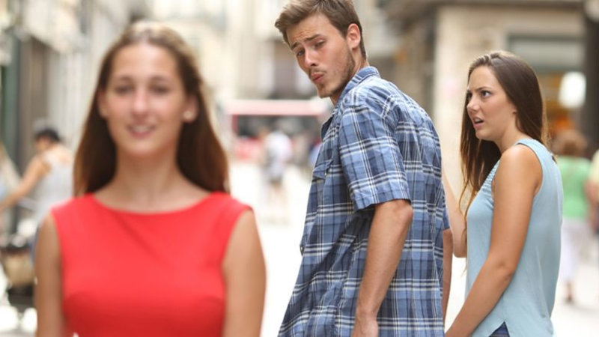
WebP
JPEG XR

Slide 25
Most importantly, it’s easy to create WebP images.
You can either use a command-line tool, or an application like Squoosh.

Slide 26
SVG
I’m still ecstatic that ‘squoosh’
is an actual term.

Slide 27
SVGs are vector graphics.
This means that it uses maths (lines, points, and polygons) to create an image.

Slide 28
Your browser interprets the maths and renders the image for you.
Because the image is not pixels on a grid, it can be resized without any quality loss whatsoever.

Slide 29
SVGs are great for things like text, logos, or simple images like cartoons.
They are not great for images that need to be photorealistic.

Slide 30
References
Streaming delays mentally taxing for smartphone users
https://www.ericsson.com/en/press-releases/2016/2/streaming-delays-mentally-taxing-for-smartphone-users-ericsson-mobility-report
Why does speed matter?
https://web.dev/why-speed-matters/

Slide 31
Further Reading
JPEG XR Codec Overview
https://docs.microsoft.com/en-gb/windows/win32/wic/jpeg-xr-codec
Make the Web Faster: WebP
https://developers.google.com/speed/webp/
MDN: SVG Definition
https://developer.mozilla.org/en-US/docs/Glossary/SVG

